Slide 1
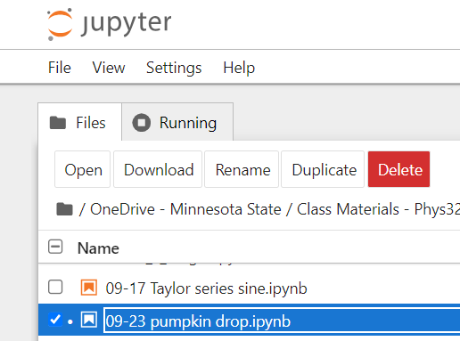
09-25
Fixing an annoying thing about lists of numbers
Code snips from

Slide 2
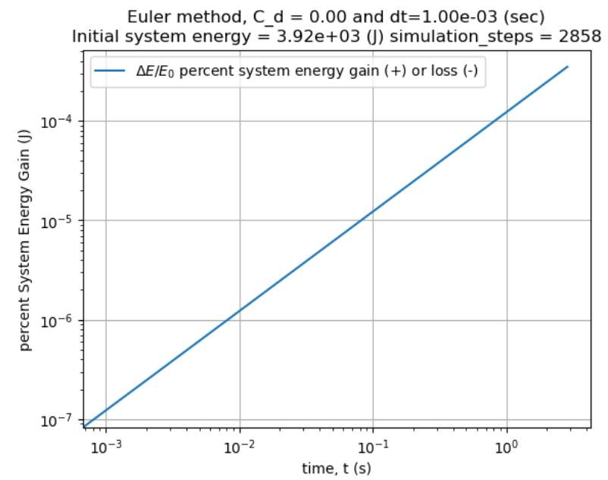
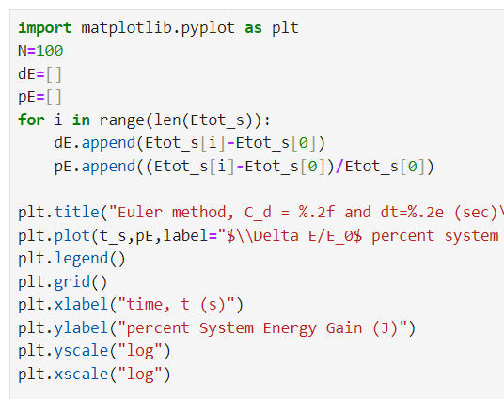
Why can’t I do this all at once?

Slide 3
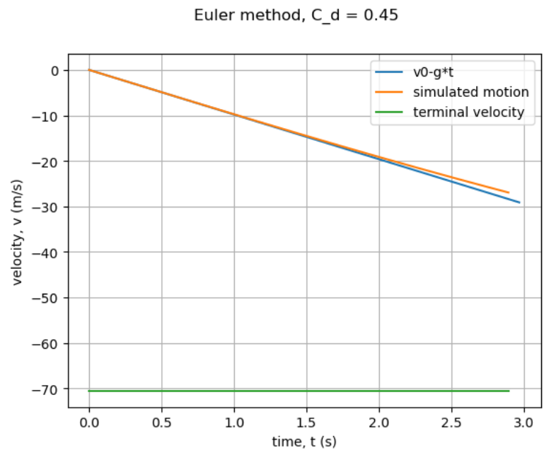
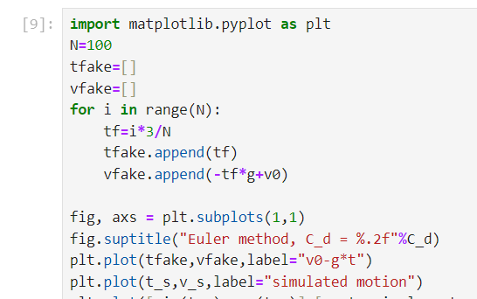
Why can’t I do this all at once?
This seems dumb!!!

Slide 4
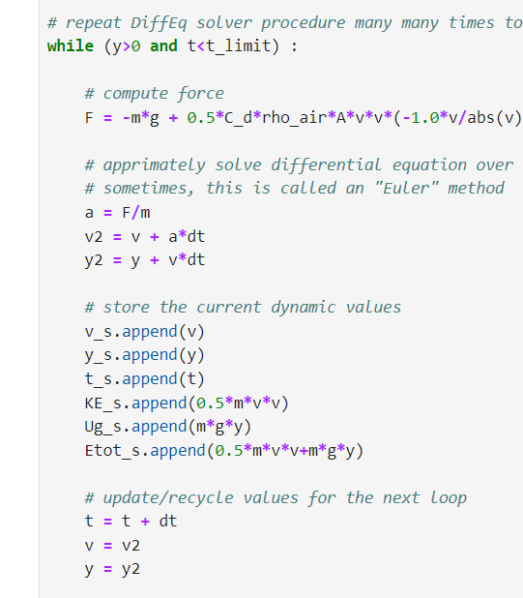
Life would be easier if I didn’t have to precompute this stuff!

Slide 5

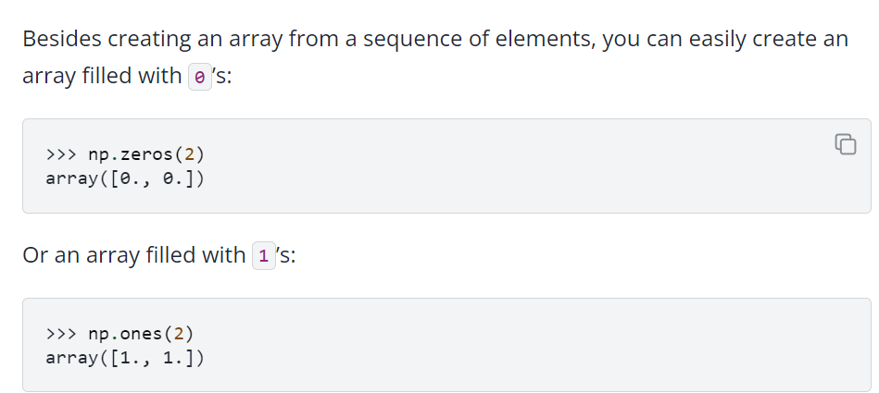
https://numpy.org/
https://numpy.org/doc/stable/user/absolute_beginners.html
https://numpy.org/doc/stable/user/absolute_beginners.html#how-to-create-a-basic-array

Slide 6
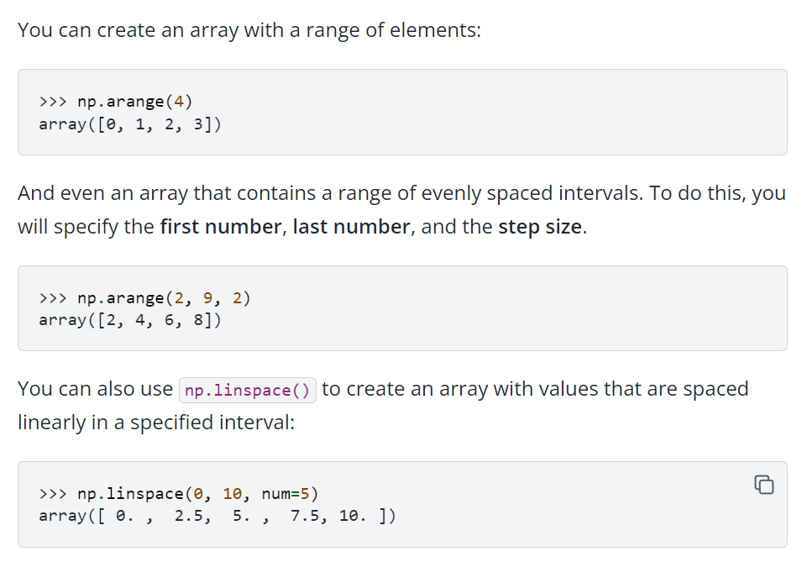
https://numpy.org/doc/stable/user/absolute_beginners.html#how-to-create-a-basic-array

Slide 7
